Slide 1
Assuming you have the MicroAeth Manager software installed-
https://aethlabs.com/microaeth/software/ma/update-microaeth-manager#

Slide 2
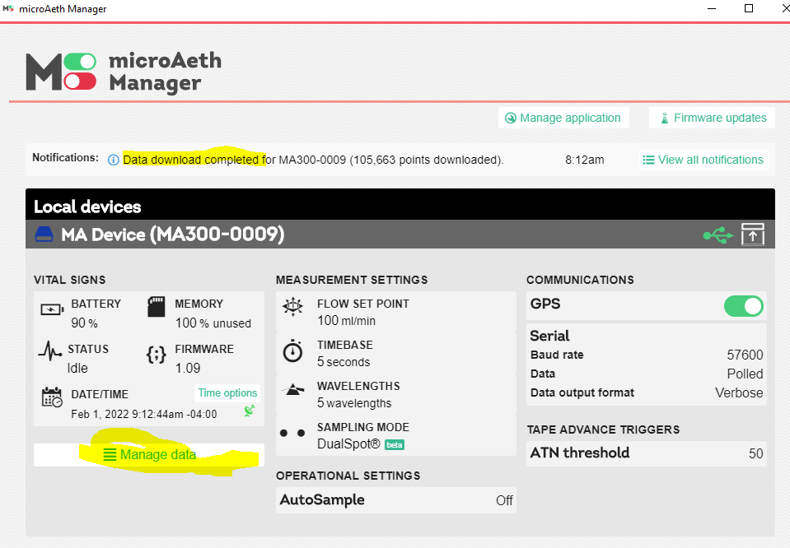

Slide 3
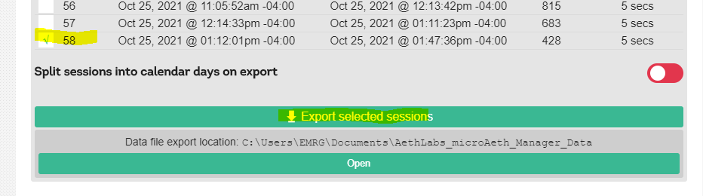

Slide 4
The you can then go MA300 Aethalometer dashboard:
https://aethlabs.com/dashboard
Create an account to upload the data to the dash board. This may be where you can get the above software also..
Then..
see below-- we use a smoothing algorithm to help eliminate or smooth over negative values (this has a lot of history to it--can discuss later)

Slide 5
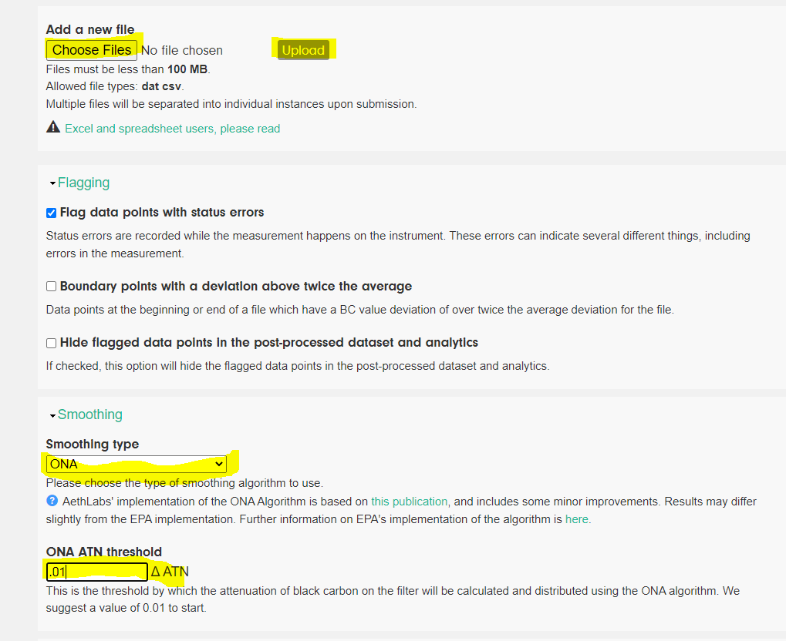

Slide 6
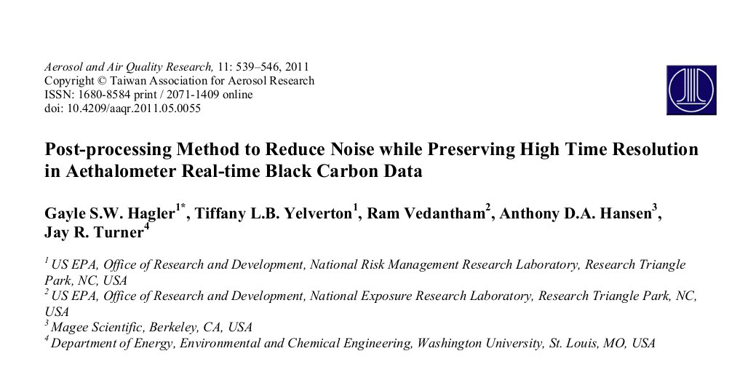

Slide 7
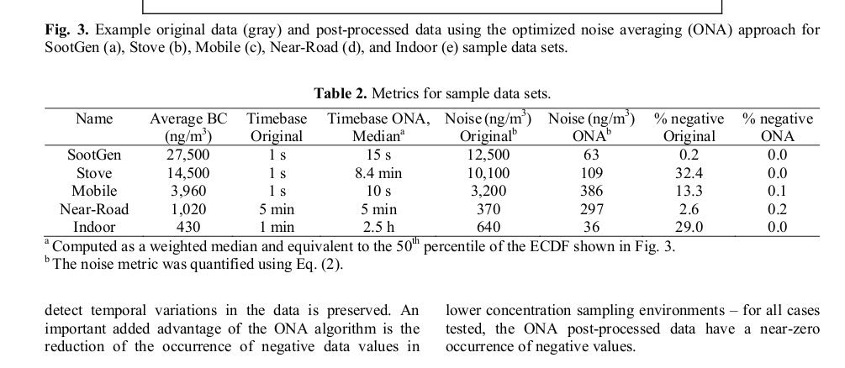

Slide 8
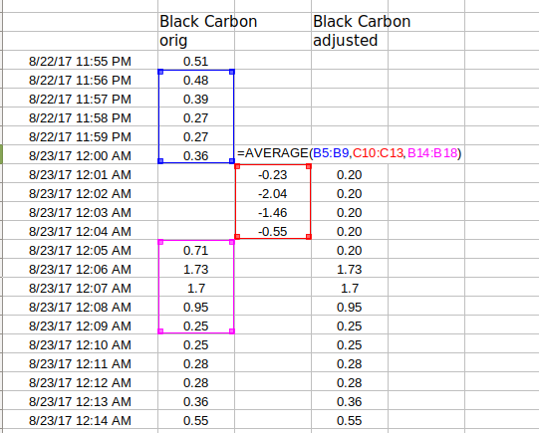

Slide 9
once you Download the file:
then click "save"
You can then download the post-processed data with the ONA algorithm, and then do the analysis.
Of course, if you choose not to use the algorithm, (or use another) you can do that to.

Slide 10
Partector

Slide 11
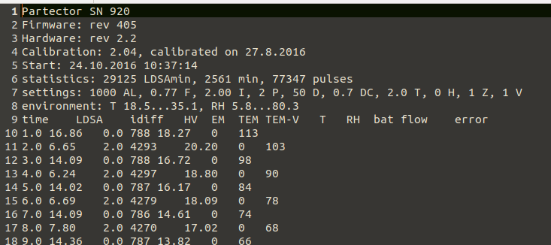
Raw data Partector 1

Slide 12
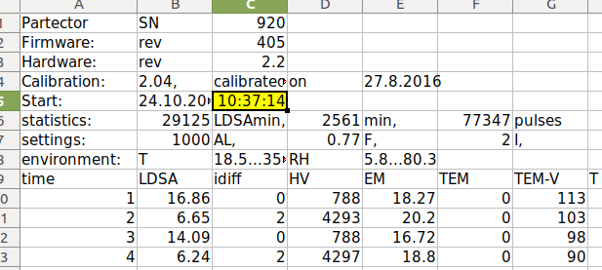
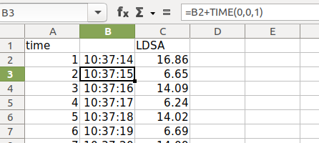

Slide 13
https://www.naneos.ch/#download

Slide 14
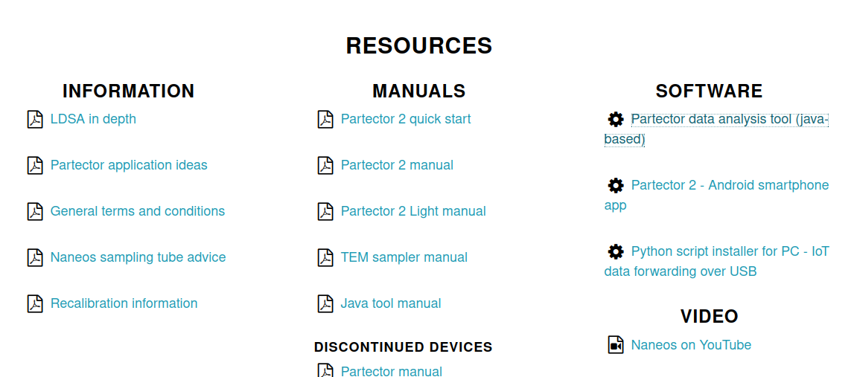
Partector

